Slide 1

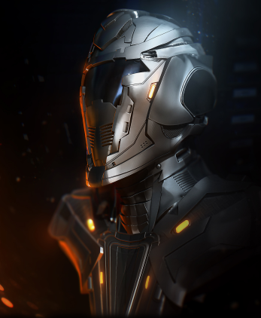
DOMINATION DUEL
A card game by Project Group 5
CMV1A
Pim van Zomeren
Razvan Preda
Jet Frieling
Sebastiano Mirabella
Marcel Stoepker

Slide 2
INDEX
Brief Summary
Market Research
Unique Selling Points
Concept Art
Development Process
Mechanics
- How we balanced the game
- The Domination Triangle
- Resources
- The Deck
Conclusion

Slide 3
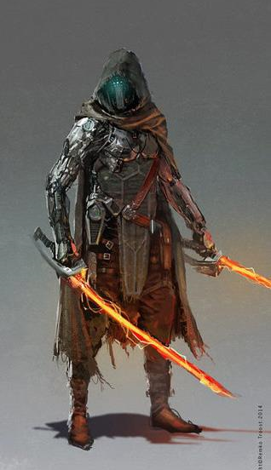
BRIEF SUMMARY
Two players duel type card game
Sci-Fi setting combined with medieval fantasy
Activating character cards, using them to fight the opponent’s defense
Using special cards (which use up energy) alongside effects and spells, in an attempt to gain the upper hand
Balance of the game includes random occurences and luck-based system, combined with strategy

Slide 4
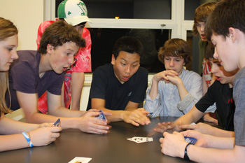
MARKET RESEARCH - AUDIENCE
Target audience covers a large field of interaction
Appeals to both teenagers and adults

Slide 5
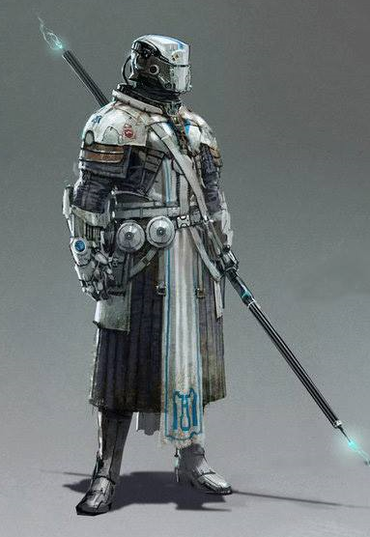
UNIQUE SELLING POINTS
An authentic take on a fusion between Sci-Fi and medieval fantasy
Rather short but intense gameplay, with a well distributed balance
A mechanic that implies random occurences and unexpected outcomes

Slide 6
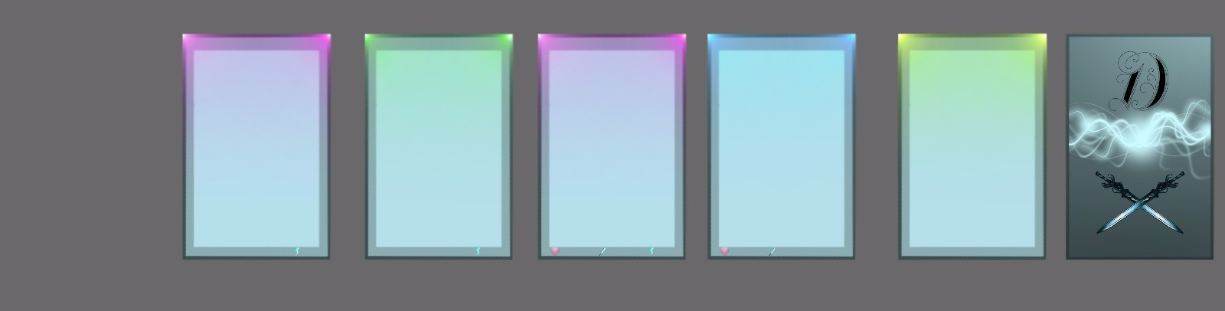
CONCEPT ART – CARD DESIGN
Special Character
Special Card
Spell
Character
Effect

Slide 7
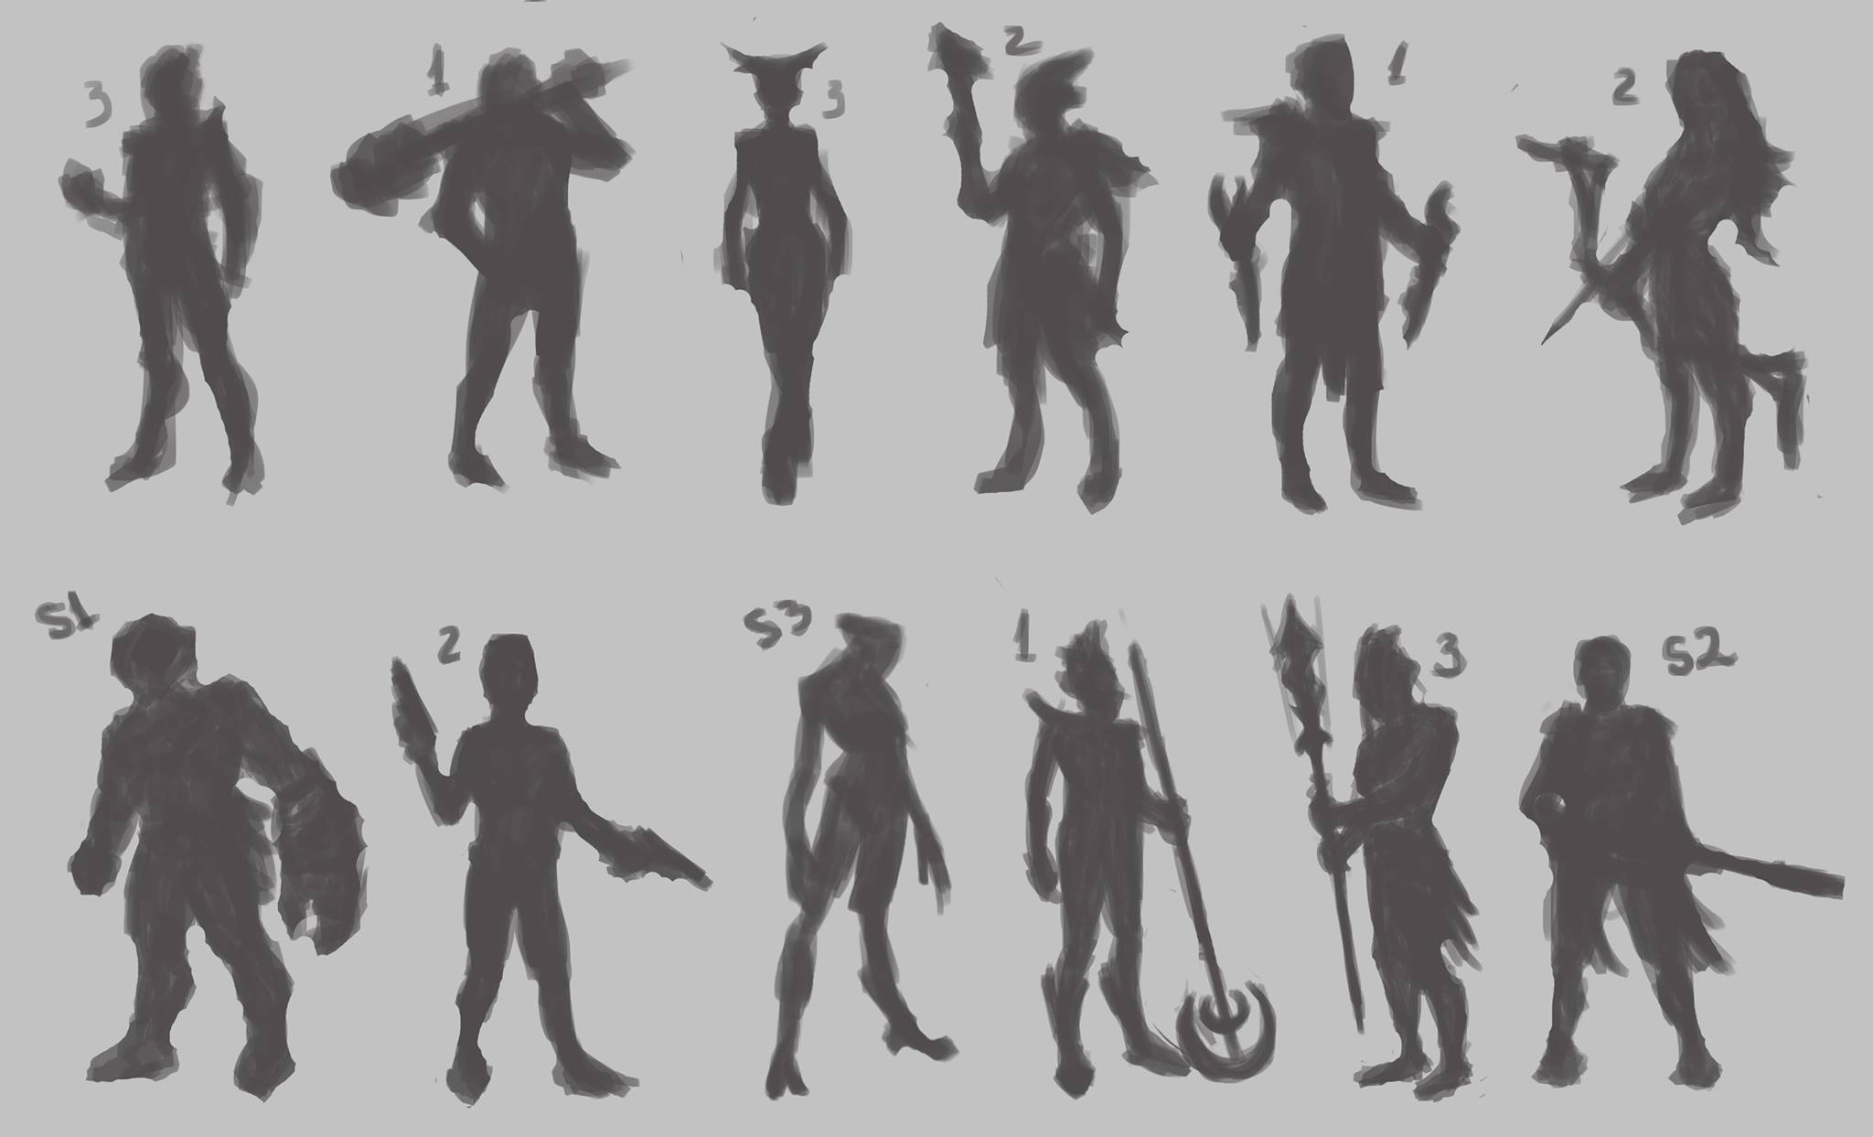
CONCEPT ART - CHARACTERS

Slide 8
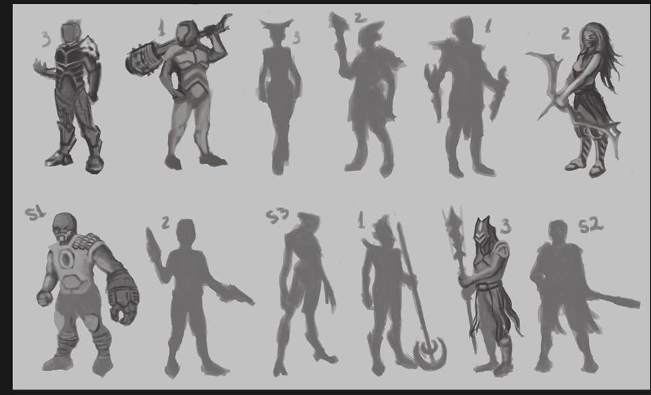
CONCEPT ART - CHARACTERS

Slide 9

DEVELOPMENT PROCESS
Coming up with a unique theme and style
Thinking of ways to make the game realistic, by having strategy combined with random events
Implementing a system to collect resources and use those resources to your advantage
Balancing the game, in terms of number of cards, health points, resources and their expences

Slide 10
HOW WE BALANCED THE GAME
Balanced mechanics with the use of the “Domination Triangle”
Use of a die to gain energy
Positive and Negative effects
Characters cost no energy
Players start with 5 energy
Players have the same chance of getting a special card

Slide 11
THE DOMINATION TRIANGLE
Ranged
Melee
Mage
Melee +2 Vs. Ranged
Ranged Vs. Mage -2
Mage +1 Vs. Melee

Slide 12
RESOURCES
There are three different resources involved:
Energy
Health Points of the player
Health Points of the character
Attack of the character
Spells, Effects, Special Cards

Slide 13
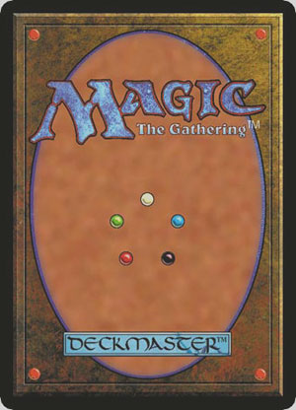
THE DECK
Our Deck is composed of 75 cards
11 Special Cards
20 Effects
15 Characters
28 Spells

Slide 14
CONCLUSION
Appealing game to a large audience
Unique Concept Art and characters
Unpredictable game-play
Fun and interactive

Slide 15


